Slide 1
“The Flaw of Averages” and Introduction to Monte Carlo Simulation Using Shiny
Ralph Asher
https://www.linkedin.com/in/ralphasher/
https://github.com/ralphasher/montecarlo_simulation
Twin Cities R Users Group Meetup
May 21, 2020

Slide 2




Who Am I? Where am I? Why am I?
BS Physics, Valparaiso University (Indiana) 2006
MS Operations Research, Florida Inst. Tech. 2012
US Marine Corps, 2006-2012
General Mills: Supply Chain Analytics Consultant, 2013-2015
Target: Operations Research Analyst, 2015-Present
BI, statistical modeling, optimization, simulation, heuristic algorithm development… and SQL… and Excel Pivot Tables
E-Commerce Network Design, modeling the future of Target E-commerce Supply Chain
R user since 2012
Math and map enthusiast since ~1990

Slide 3
Purpose of This Talk
How can we use data, math, and advanced analytical methods to understand risk and uncertainty?
Introduction to “the flaw of averages” and thinking in terms of ranges, not single values
Conceptual Introduction to Monte Carlo Simulation
Using Shiny for interactive Monte Carlo Simulation

Slide 4
How can we use data to understand risk and uncertainty?
Most people are inherently paralyzed by uncertainty, and tend to ignore it in our lives.
Will my home burn down today?
Will I get sick?
Will the Chipotle line be too long, to make it back to work on time?
Our typical decisions are based either upon heuristics (good rules of thumb), or a single estimate
Will I make it to the airport in time?
How much can I afford on a mortgage?
Our ability to objectively evaluate decisions, declines with complexity and uncertainty about the important details
Should I go to college?
Should I take that job?
Should I marry this person?
Enabling decision-making under uncertainty, absent of emotion, is a major triumph of operations research
Thinking, Fast and Slow
Fooled By Randomness
Farnam Street (website)

Slide 5
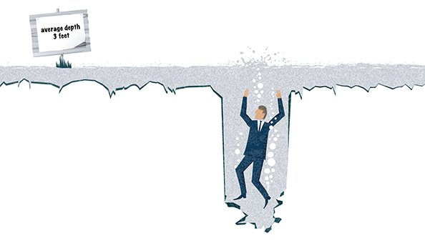
“The Flaw of Averages”
Inputs to key decisions (for example, sales forecasts, travel times, cost inputs) are not a single point value, but a range (distribution)
Making decisions based on the average of those values, ignores potential impacts of those inputs coming in higher or lower than average
If you can’t swim… don’t try to cross a creek based upon its “average” depth
Popularized by Dr. Sam Savage in 2002 Harvard Business Review article, and subsequent book
Spoilage and Out of Stocks vs. “Average” Demand
https://hbr.org/2002/11/the-flaw-of-averages
Notes:
https://hbr.org/2002/11/the-flaw-of-averages
Probabilitymanagement.org

Slide 6
Monte Carlo Simulation
Analytical method that evaluates a lot of potential combinations of uncertain inputs – drawing from their range of possibilities – and calculates the overall outcome
“It shows the extreme possibilities—the outcomes of going for broke and for the most conservative decision—along with all possible consequences for middle-of-the-road decisions.”
Invented during World War 2 Manhattan Project (atomic bomb), named after the Monte Carlo casinos
Helps decision-makers identify the range of total outcomes, including the “expected range” as well as “tail risk” (unlikely but highly impactful outcomes)
Finance (stress testing, mergers & acquisitions), Oil & Gas (investment decisions on drilling oil wells)
Notes:
Quote from Palisade https://www.palisade.com/risk/monte_carlo_simulation.asp

Slide 7
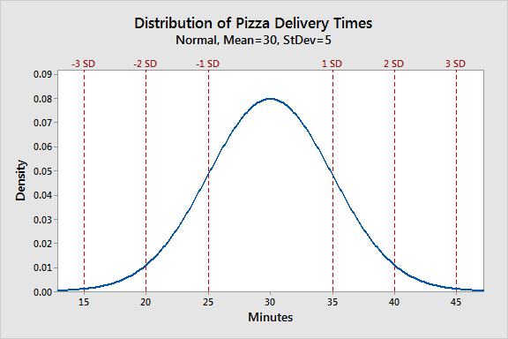
Bell Curve (Normal Distribution)
In a normal distribution:
The average value is the most common
Mean (average) = median (middle value)
“Standard deviation” describes the likelihood of a range of outcomes:
68% of values are within +/- 1 standard deviation
95.5% of values within 2 SD
99.7% of values within 3 SD
“Tail Risk” are those unlikely, but impactful outcomes… a pizza that comes in 5 minutes or 55 minutes
In this talk, all the inputs will be normally distributed
Notes:
Thanks to whoever’s website was scraped by Google Images.

Slide 8
Monte Carlo Simulation – Ralph & Bob Going to Dinner
Ralph and his next-door neighbor Bob both work downtown, by the Wells Fargo Center
Ralph and Bob both take the same bus routes, to and from work
Reservations to go to dinner at 6:15pm on a weeknight at a popular restaurant in our neighborhood… will we make it in time?
We each leave our desks at 5:30pm, head home, and once both are home, we’ll walk to the restaurant.
Commute from downtown to home is 30 minutes on average, with a bell curve – sometimes longer (snowstorms! Bus breaks down!), sometimes shorter (no traffic and the bus is pulling up when I get to the stop!)
Walk time from our houses to the restaurant is 10 minutes on average, with a bell curve
Expected Arrival Time, Based Upon Averages: 5:30pm + 30mins commute + 10mins walk = 6:10pm. 5 minutes early!
Notes:
Quote from Palisade https://www.palisade.com/risk/monte_carlo_simulation.asp
We’ll use monte carlo simulation to pick random values from the range of potential commute times for Bob and I. Even though we leave our offices at the same time, we may not get on the same bus so our commute time may be different. We’ll then see what time we get to the restaurant and find out if we made it.

Slide 9
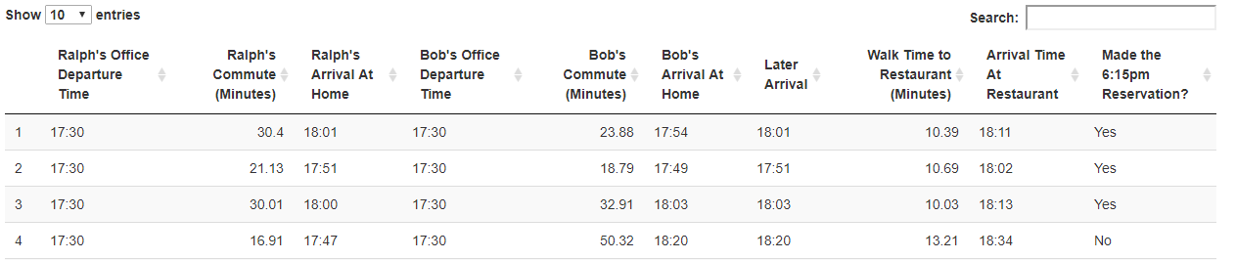
Monte Carlo Simulation – Ralph & Bob Going to Dinner
First simulation: I get home at 6:01pm, Bob got home at 5:54pm. When I got home at 6:01pm, we took about 10 minutes to walk to the restaurant… arrived 6:11pm. Right on average!
Second simulation: we both have a really short commute, get there 13 minutes early!
Third simulation: Bob’s commute was a little longer than average, but we got there two minutes early….
Fourth simulation: Bob’s commute was horrid. We missed our table.
Notes:
So what happened in the fourth simulation ? Even though my commute was really short, Bob’s wasn’t, and our average commute was 34 minutes between us… we didn’t get there in time. How often does that happen?

Slide 10
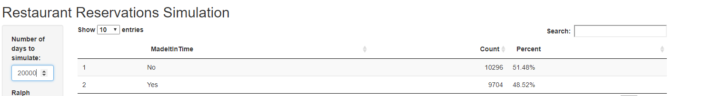
Rinse and Repeat 20,000 Times…
We missed our reservation about half the time, by planning based upon the average
Notes:
Questions to group… why did we miss it over half the time?
Whoever is later to get home, Ralph or Bob, is the primary factor for whether we end up early, on time, or late.
Is showing up 40 minutes late bad? Is showing up 40 minutes early good?

Slide 11
Rinse and Repeat 20,000 Times…
Work from Shiny app… how does the probability of making it on time change?
Leave the office earlier (5:15pm)
More predictable commute (sd=3 instead of 10)
Average commute time stays at 30 minutes but range gets smaller, making it more predictable and closer to the “expected” result

Slide 12
Takeaways
Monte Carlo simulation – incredibly helpful tool for evaluating potential outcomes of uncertain inputs
Any platform: Excel / R / Python
Spurs important discussions on a range of outcomes and the impact on decisions

